Slide 1

.
Online Supply Solution for Farm Produce
.
Samala Hari prasad (12309909)

Slide 2

Overview
The Crop Cart app is a digital platform that is designed to connect farmers directly with consumers, retailers, and wholesalers. It enables farmers to sell produce online, track inventory, get fair prices, and access delivery/logistics assistance —simplifying the farm-to-market process.
Problem Statement
Farmers, especially small-scale ones, face issues like low profits due to middlemen, limited market access, and poor technological integration. Consumers also lack a direct channel to purchase fresh farm produce. There is a need for a digital solution to bridge this gap.

Slide 3

Research Goals
Research Objectives
Determine the main obstacles farmers face when trying to sell their produce.
Recognize the needs of buyers (consumers, retailers) for reasonably priced, fresh farm produce.
Create a smooth online marketplace for farm-to-consumer sales.
To strengthen the agricultural supply chain and facilitate the sale and distribution of farm products by developing an intuitive, dependable, and expandable web platform for Indian farmers.
Research Hypothesis
By offering a digital platform that links farmers and buyers directly, farmers' profit margins will increase.
Give customers access to fresh produce.
Build a traceable, open, and effective supply chain.

Slide 4

Interview Questionnaire
Sample Size : 5
Target Audience : Farmers, Small Retailers, Consumers
Occupation : Farmers, Vegetaa, Small business owners
Location : Maharashtra, Telangana
Sampling Method : Convenience Sampling
Data Collection : Personal interviews and telephonic conversations

Slide 5

Interview Questionnaire
Need-Based:
1. What challenges do you face while selling or purchasing farm produce?
2. How do you manage inventory or supply demand?
3. What tools do you currently use to sell/buy farm goods?
Task-Based:
1. Describe your daily farming/business routine.
2. How do you transport, store, or handle perishables?
Value-Based:
1. How important is direct-to-consumer selling for you?
2. What's your ideal way of managing produce and sales digitally?

Slide 6
Company | Target Audience | Features | USP | UX | Pricing
AgriBazaar | Farmers, Traders | Price alerts, Bidding | Government integration | Informative, rural language support | Free
KisanKonnect | Farmers, Households | Home delivery, Farmer stories | Direct farm-to-home | Clean & easy navigation | Subscription
DeHaat | Farmers | Advisory, input sales | End-to-end agri solution | Multilingual support | Hybrid (Free + Paid)

Slide 7

Top 4 Insights & Findings
Need for Transparency & Better Prices: Farmers are unaware of real-time market rates.
Lack of Storage/Delivery Solutions: Perishables often spoil due to delays.
Desire for Digital Simplicity: Users want apps in local languages with intuitive UX.
Connection Gap: Farmers want to reach buyers directly without middlemen.

Slide 8
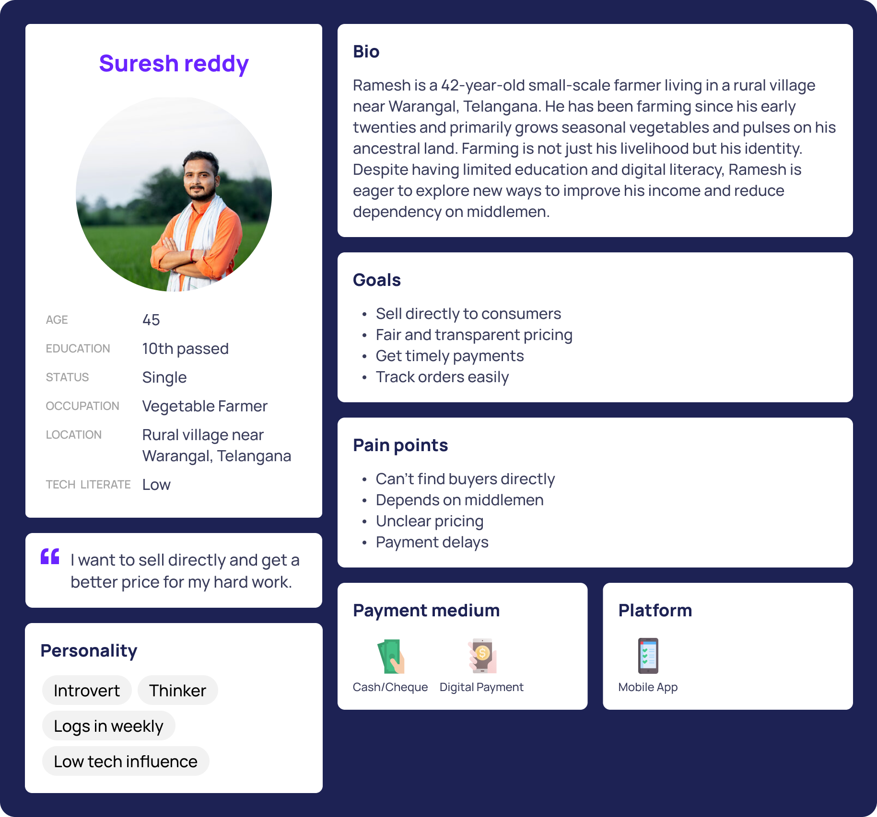
Person 1 farmer

Slide 9
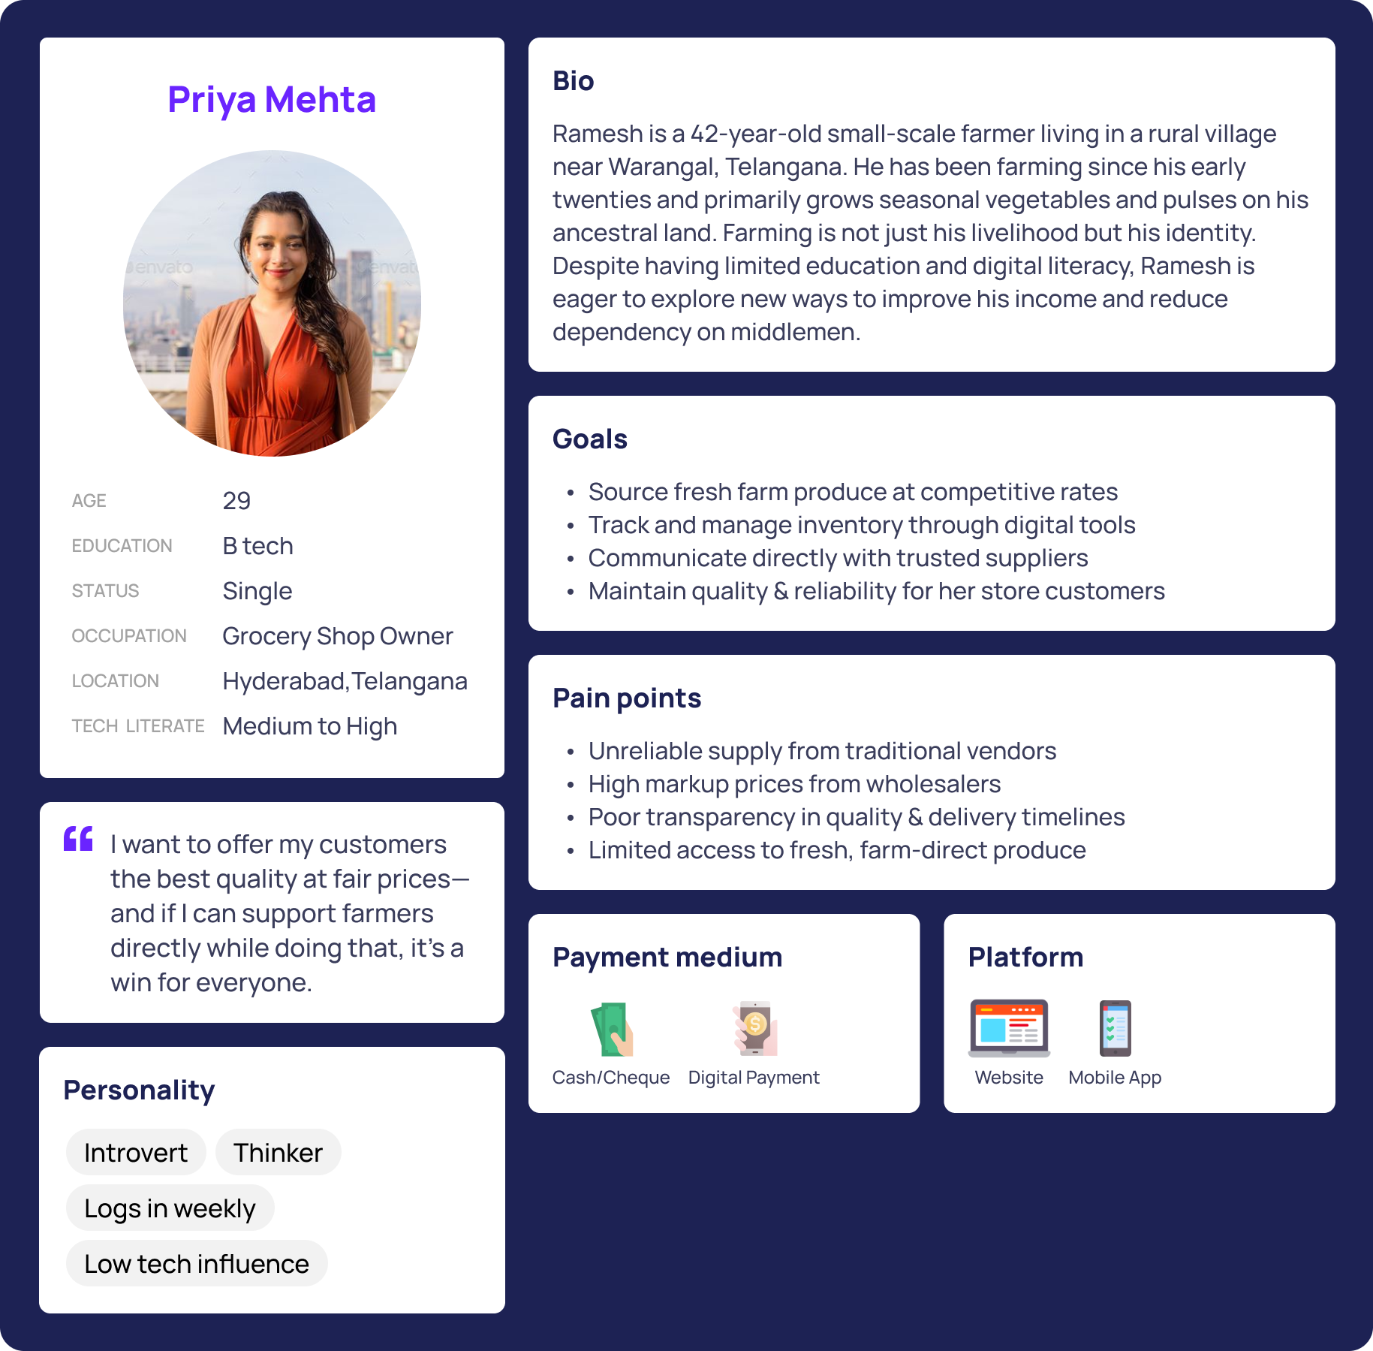
Persona 2 Urban user

Slide 10
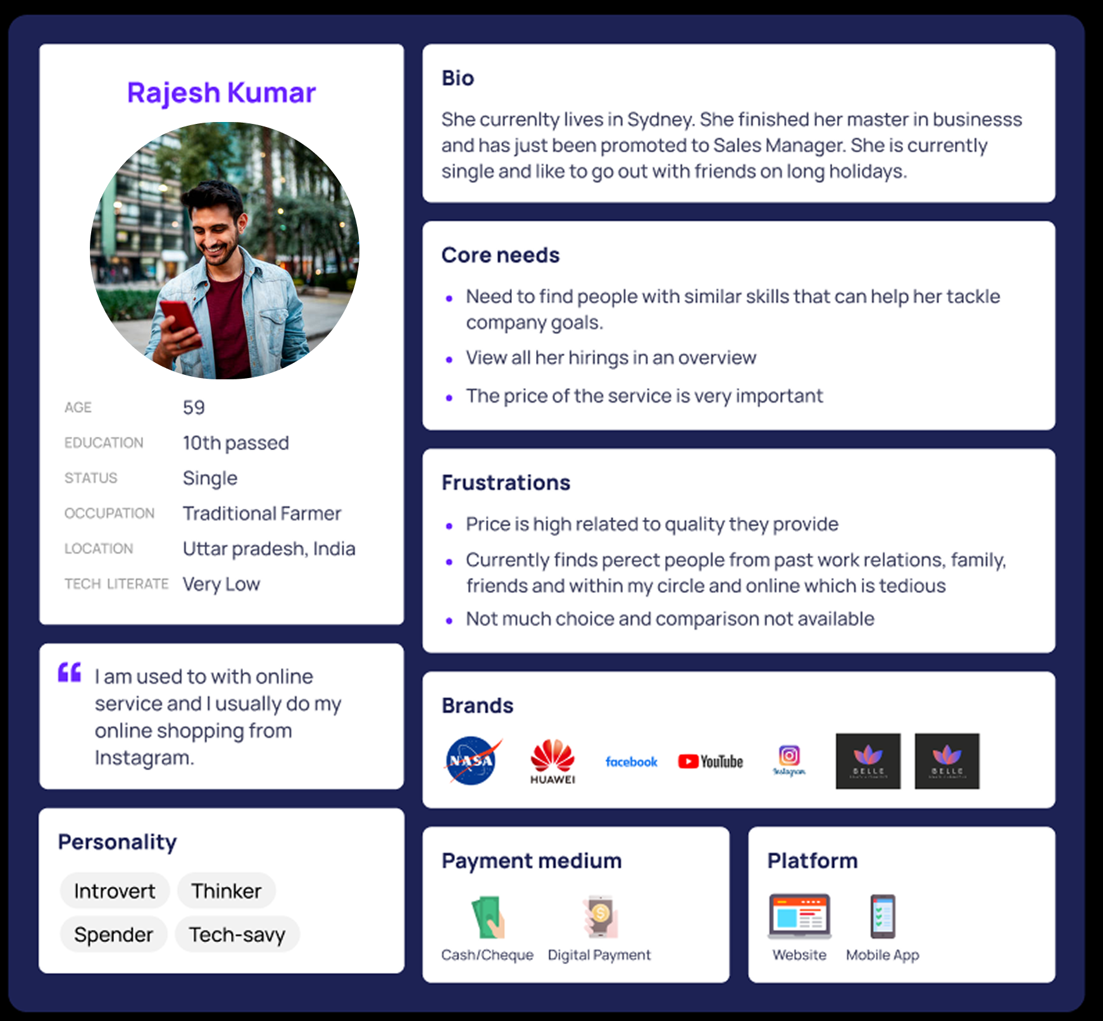
Negative persona

Slide 11
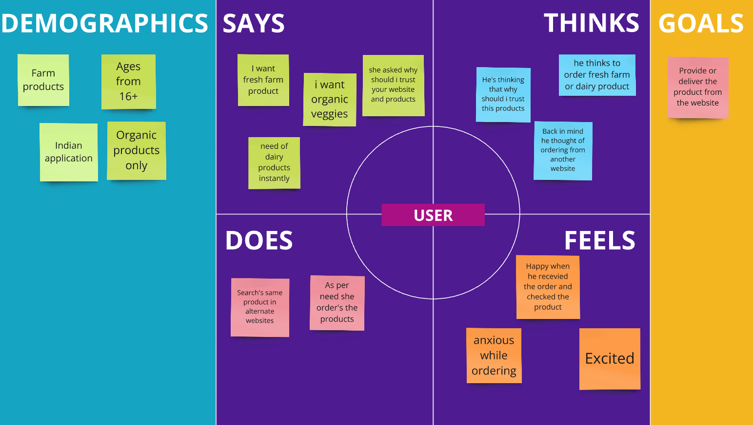
Empathy Mapping

Slide 12
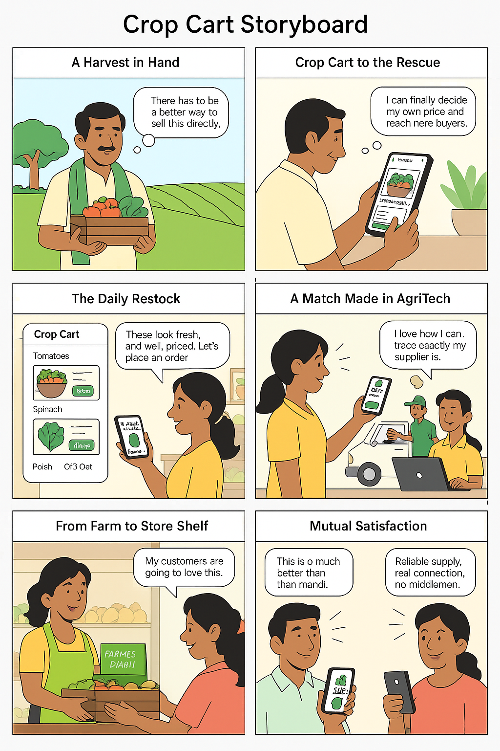
Story boarding

Slide 13
Customer Journey Map
Stage | Add Produce | Confirm Order | Payment | Delivery | Feedback
Action | Uploads crop | Accepts order | Gets paid via UPI | Logistic partner delivers | Leaves rating
Touchpoints | App | Notifications | UPI/Wallet | Tracking feature | Feedback form
Emotions | Hopeful | Happy | Satisfied | Anxious | Proud

Slide 14
Service Blueprint
Stage | App Upload | Order Confirm | Payment | Logistics | Post-Delivery
Frontstage | Product form | Order status update | UPI confirmation | Real-time tracking | Rating screen
Backstage | Crop DB | Order processing | Payment split | Delivery scheduling | Follow-up message
Support | Helpdesk | Chatbot | FAQs | Route planning | Returns & Refunds

Slide 15
Information Architecture
Main page
Home
Shop
Communtiy
My order
Shopping cart
Contacts
Payment
Support
Log out

Slide 16
TASK FLOW
Sign-up/log-in
Consent Form
Location
Allow/deny
Main Page
Download
Regitser as a farmer
Continue with google
Home
Shop
farmers
My order
Shopping cart
Products page
Previous order
Community
Payment page

Slide 17
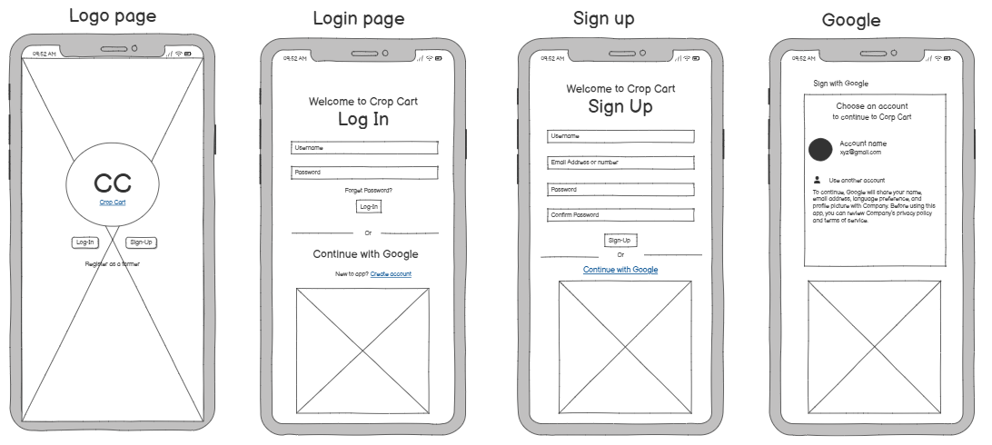
Low fidelity Wireframes

Slide 18
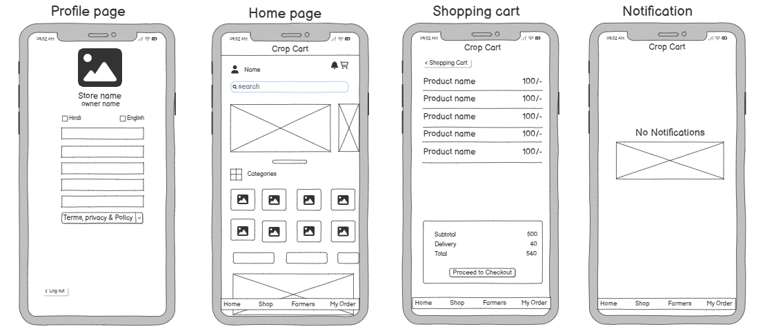
Low fidelity Wireframes

Slide 19
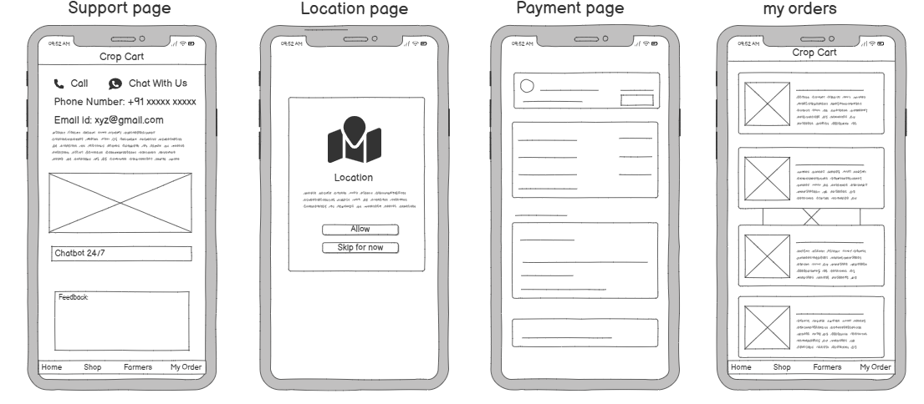
Low fidelity Wireframes

Slide 20
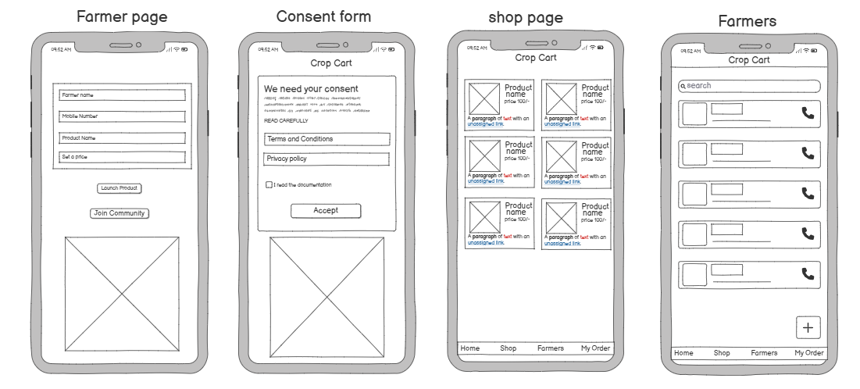
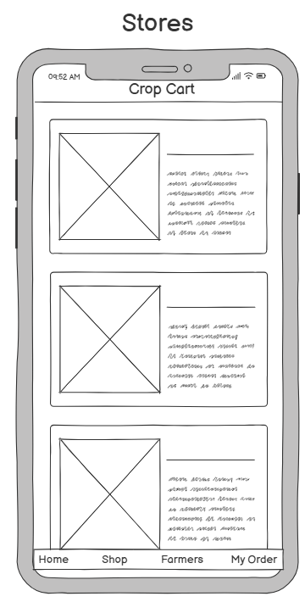
Low fidelity Wireframes

Slide 21
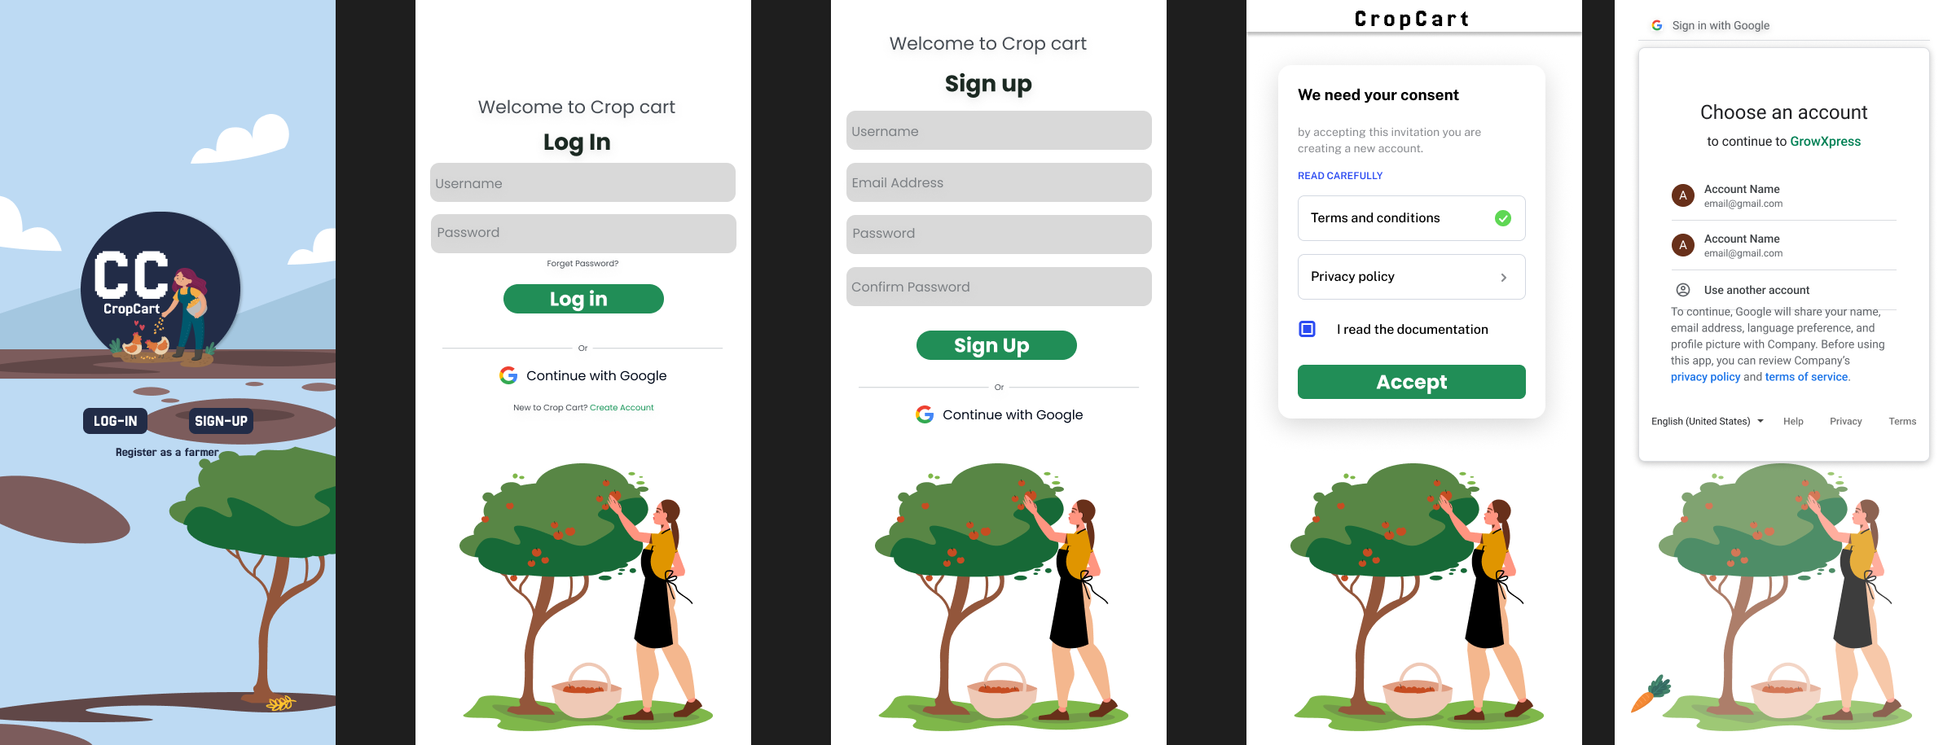
High fidelity Wireframes

Slide 22
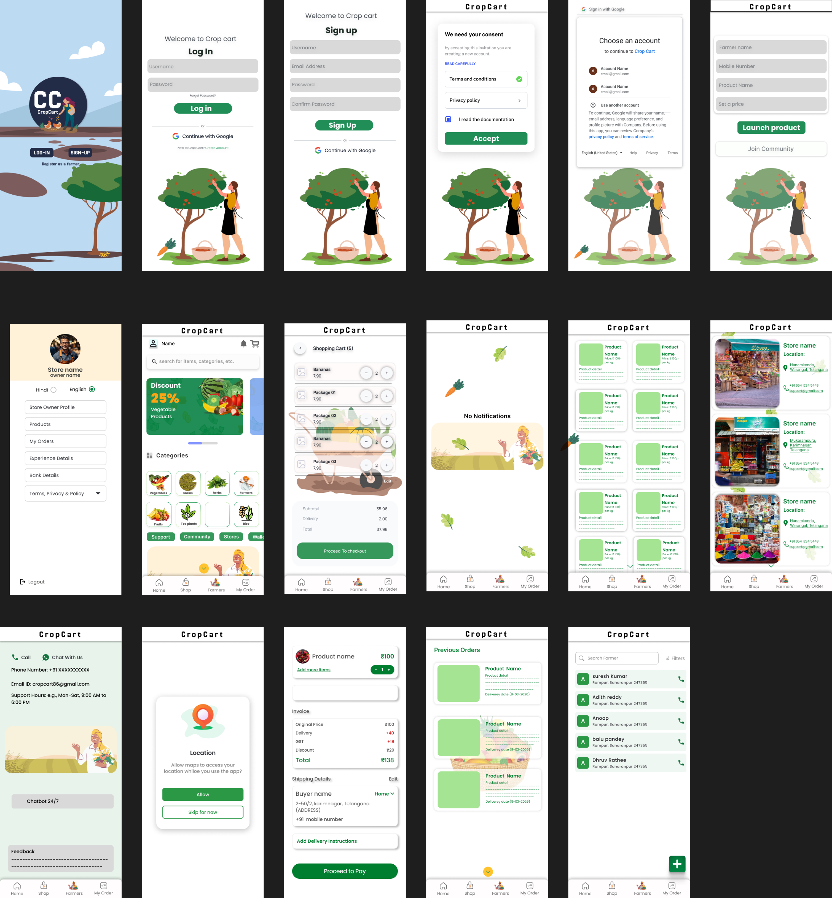

High fidelity Wireframes

Slide 23
High fidelity Wireframes

Slide 24
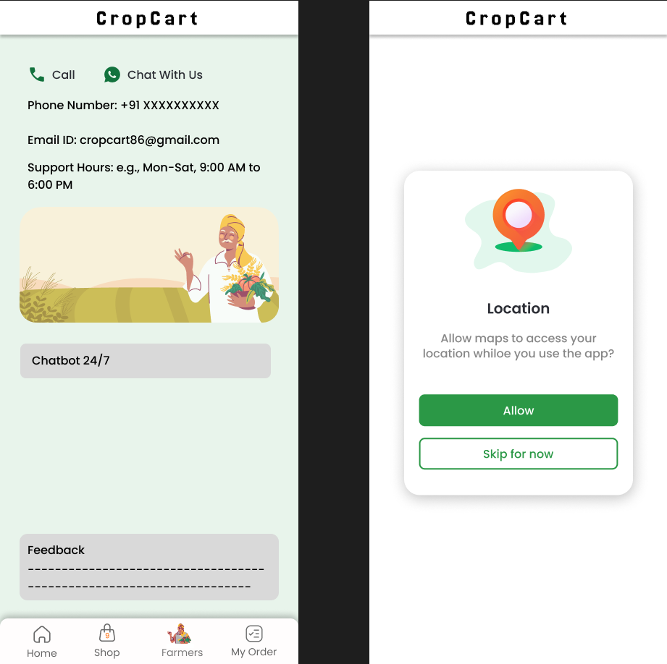
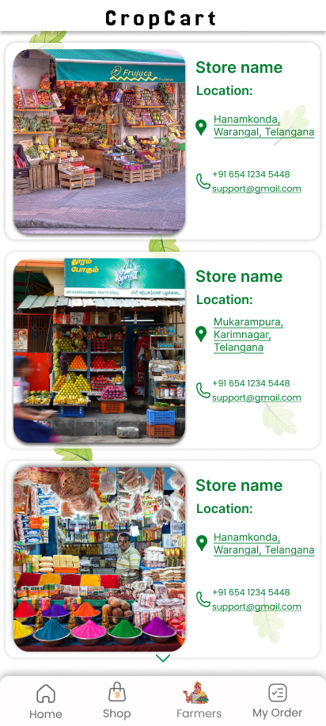
High fidelity Wireframes

Slide 25
Usability Testing
Issue | Observation | Fix Implemented
Complex sign-up process | Farmers struggled with too many fields | Added “Sign Up with Google” to simplify registration
Unclear icon meanings | Users were confused by some bottom navigation icons | Added text labels below icons
Lack of progress indicator | Users didn’t know if their product upload/order went through | Added confirmation modals and progress bars
Support was hard to find | Users didn’t immediately locate the help feature | Placed Chatbot and Call icons on the main support page

Slide 26
Usability Testing(Qualitative)
Task : Upload a crop and accept an order.
User | Time Taken | Errors | Difficulty | Assistance Needed | Feedback
1 | 28 sec | 1 | Low | No | Wanted better icon labels
2 | 30 sec | 0 | Low | No | Suggested Odia labels
3 | 35 sec | 1 | Medium | Yes | Wanted step-by-step tooltips
4 | 25 sec | 0 | Low | No | Loved the clean layout
Suggestions Implemented:
Introduced local language toggle (Hindi).

Slide 27
Links
Survey form link : https://docs.google.com/forms/d/e/1FAIpQLSffDRqMlu0fdxlxc6-ysb_6qJcS3yBDllAZJDFOym6khxvLVQ/viewform?usp=header
Empathy mapping link : https://miro.com/app/board/uXjVIW8AuIc=/?share_link_id=715215075984
Figma design link : https://www.figma.com/design/3JdGjDO0e9KtOdSZOVhm7h/Online-supply-chain-farm-produce?node-id=0-1&t=Do2JjiXi01hjYFPY-1
persona link : https://www.figma.com/design/3JdGjDO0e9KtOdSZOVhm7h/Online-supply-chain-farm-produce?node-id=92-94&t=Do2JjiXi01hjYFPY-1
Story-Boarding link : https://miro.com/app/board/uXjVIA-KZms=/?share_link_id=690433330316
Story-Boarding link : https://miro.com/app/board/uXjVIA-KZms=/?share_link_id=690433330316

Slide 28
THANK YOU

